Slide 1


Slide 2
Frontend Development

Slide 3
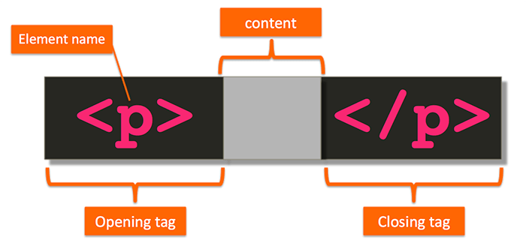
Introduction
What is Website and Webpage?
HTML stands for HyperText Markup Language.
History
Tags
Semantic Elements or tags Example : <header>,<footer> etc
Opening/Closing tags
Self Closing tags
</br>, </hr>
Notes:
In 1980, physicist Tim Berners-Lee, a contractor at CERN (European Organization for Nuclear Research) , proposed and prototyped ENQUIRE, a system for CERN researchers to use and share documents. In 1989, Berners-Lee wrote a memo proposing an Internet-based hypertext system.

Slide 4
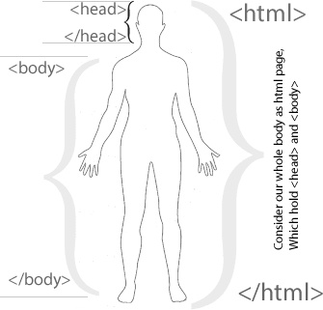
Page Structure
<!DOCTYPE html>
<html>
<head>
<title>My first HTML page</title>
</head>
<body>
<h1>First HTML page</h1>
<p>My First HTML page.</p>
</body>
</html>

Slide 5
DOCTYPE - Document TYPE
Doctype is not an HTML tag it is just a declaration of a document which tells the browser about what version of HTML the page is written in.
Old Version of Html doctype look like
<!DOCTYPE HTML PUBLIC "-//W3C//DTD HTML 4.01//EN“ "http://www.w3.org/TR/html4/strict.dtd">
HTM5 Version of doctype is pretty simple that we use
<!DOCTYPE html>

Slide 6
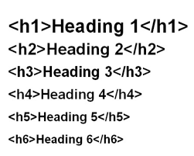
Tags that we will learn today:
Notes:
The <em> tag is written as <em></em> with the emphasized content inserted between the start and end tags.

Slide 7
Tags that we will learn today:
p (Paragraph)
em (Emphasized Element)
Strong (Strong Importance Element)
b (Bring Attention To element)
I (represents a range of text that is set off from the normal text for some reason. )
Notes:
The <em> tag is written as <em></em> with the emphasized content inserted between the start and end tags.

Slide 8

Assignment
Explore at least 5 new HTML elements and discuss them in the next class.

Slide 9
References
https://developer.mozilla.org/en-US/docs/Web/HTML
https://developer.mozilla.org/en-US/docs/Web/HTML/Element/Heading_Elements
https://developer.mozilla.org/en-US/docs/Web/HTML/Element/p
https://developer.mozilla.org/en-US/docs/Web/HTML/Element/i
https://developer.mozilla.org/en-US/docs/Web/HTML/Element/em
https://developer.mozilla.org/en-US/docs/Web/HTML/Element/b
https://developer.mozilla.org/en-US/docs/Web/HTML/Element/strong
https://developer.mozilla.org/en-US/docs/Web/HTML/Element/u

Slide 10


